Slide 1
Watson Fellowships Informational Session

Slide 2


Slide 3
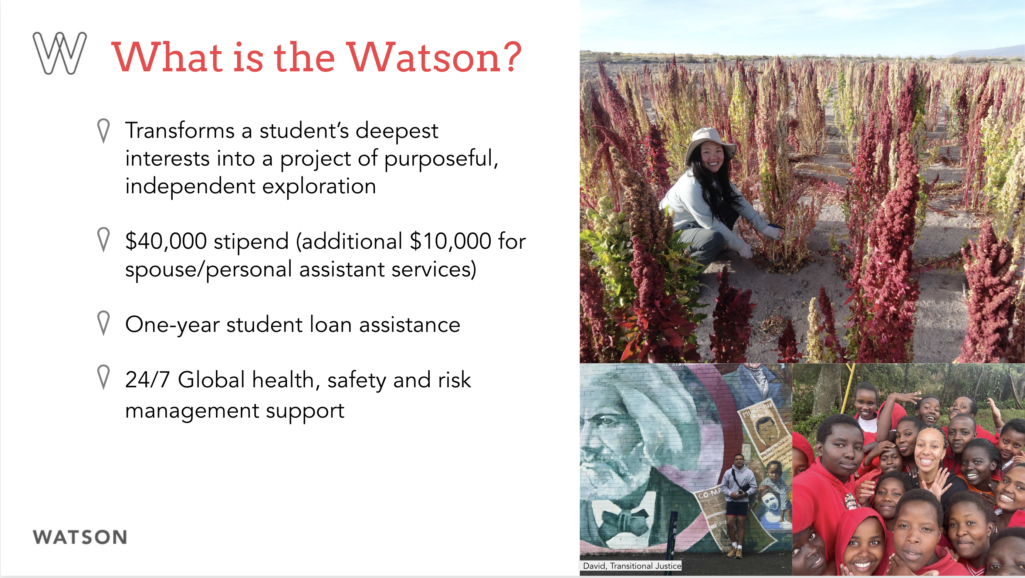

Slide 4
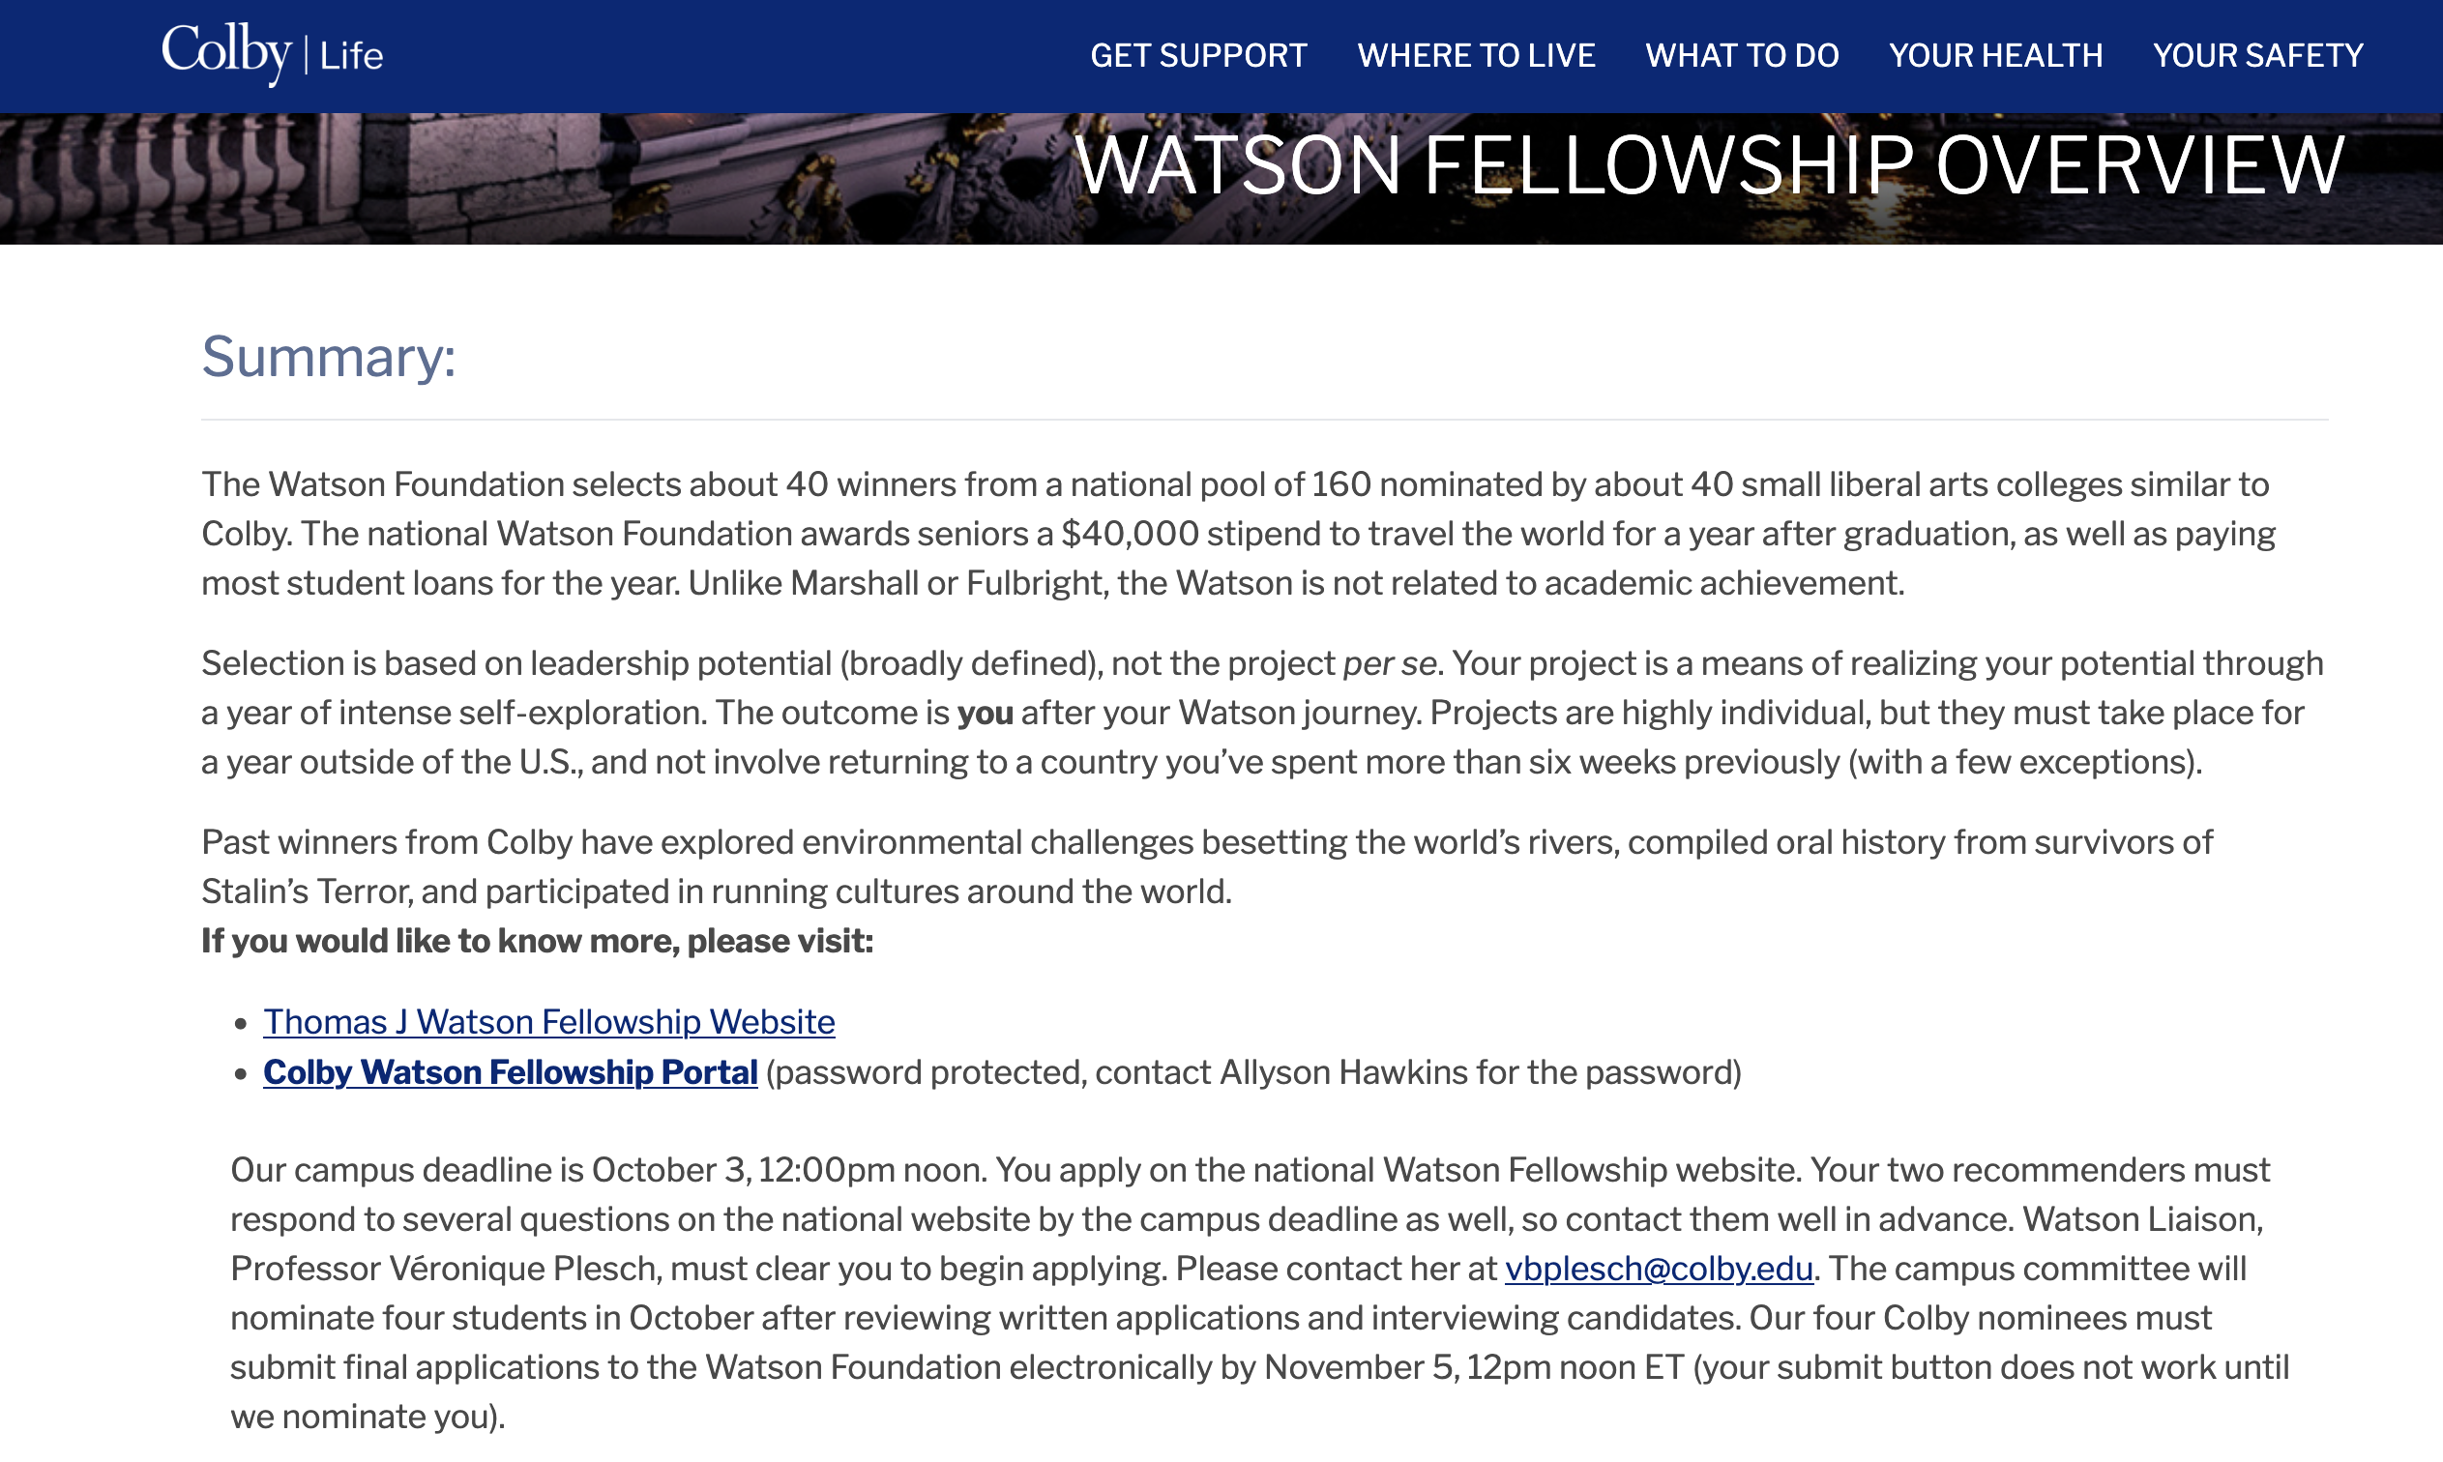
https://life.colby.edu/offcampus/watson-fellowship-overview/

Slide 5
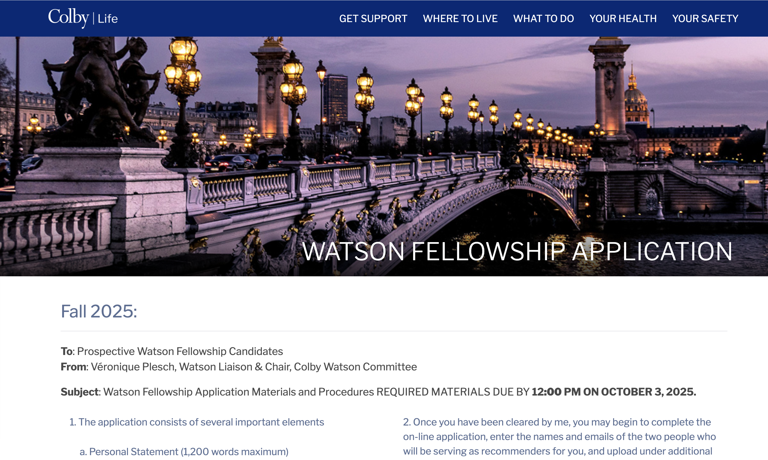
https://life.colby.edu/offcampus/watson-fellowship-application-procedures/

Slide 6
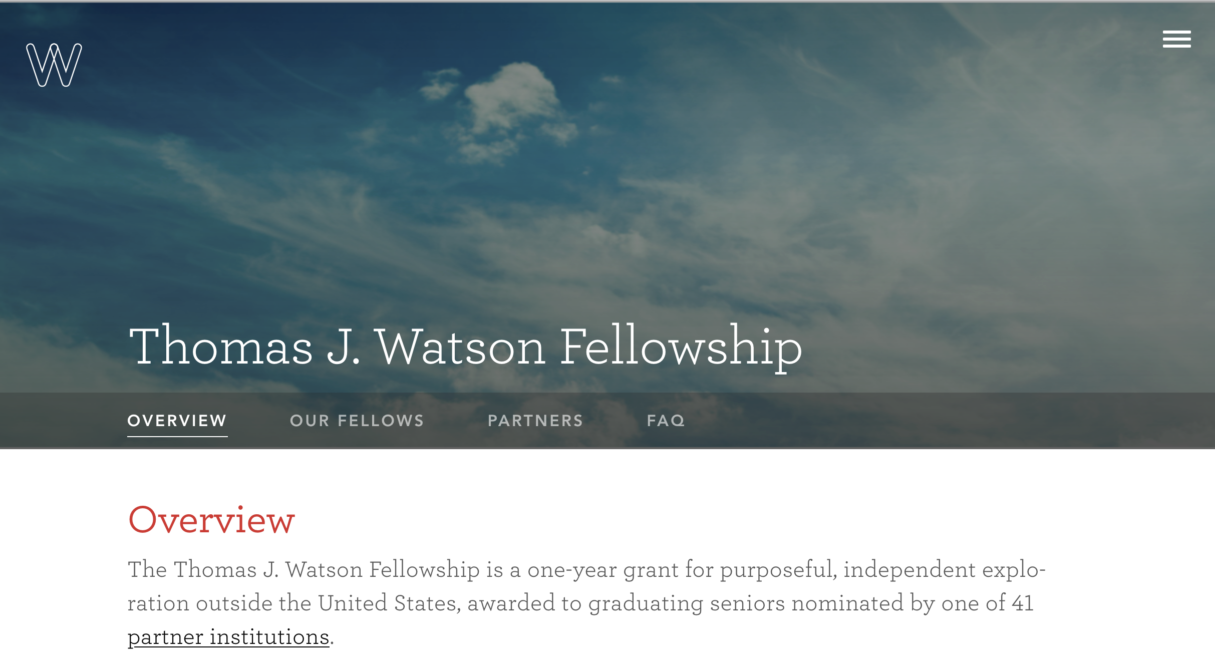
https://watson.foundation/fellowships/tj

Slide 7
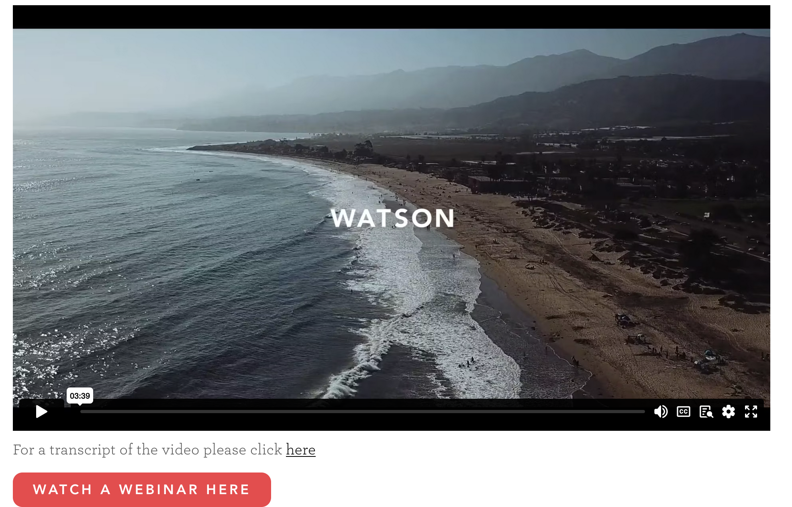

Slide 8
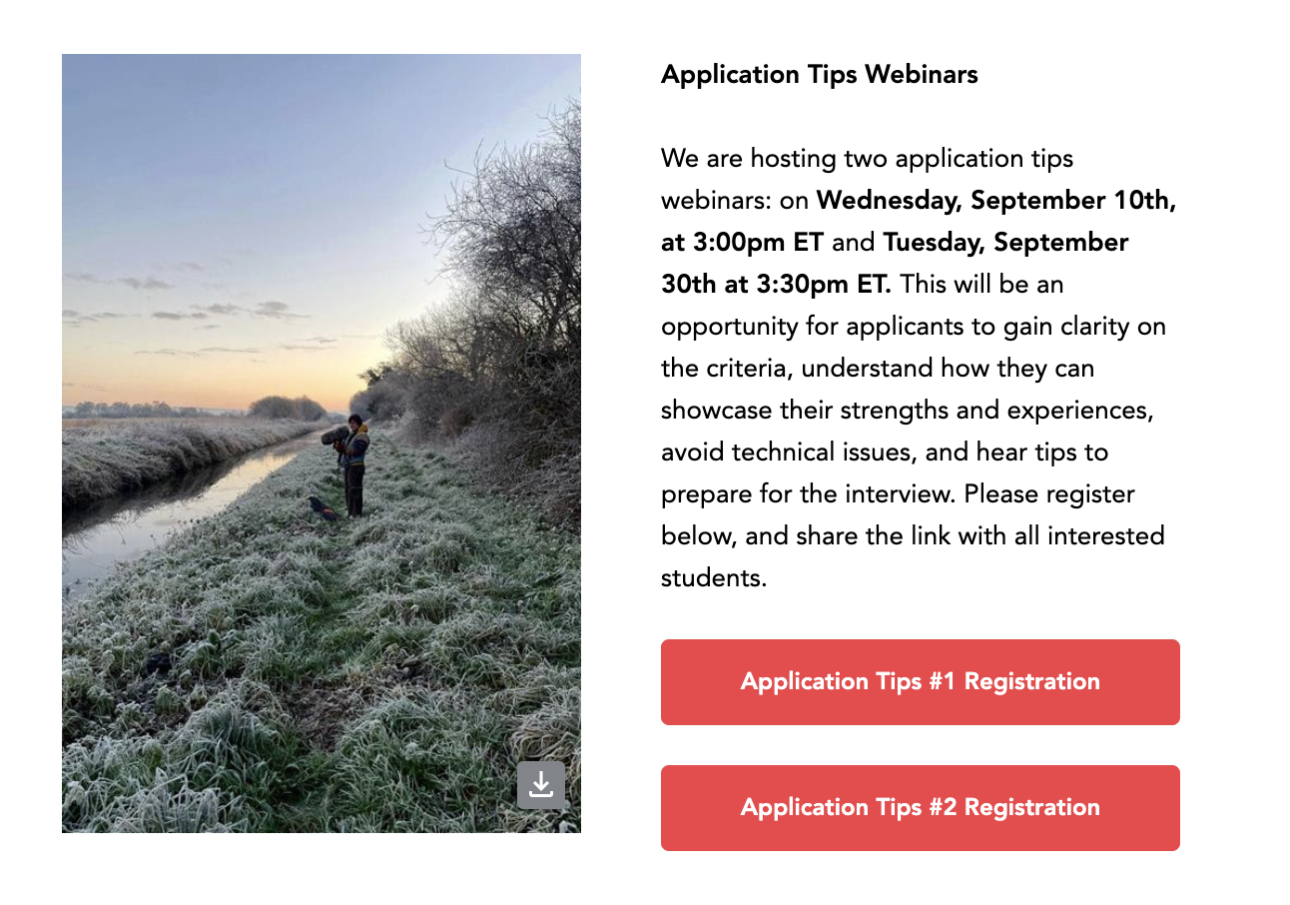

Slide 9
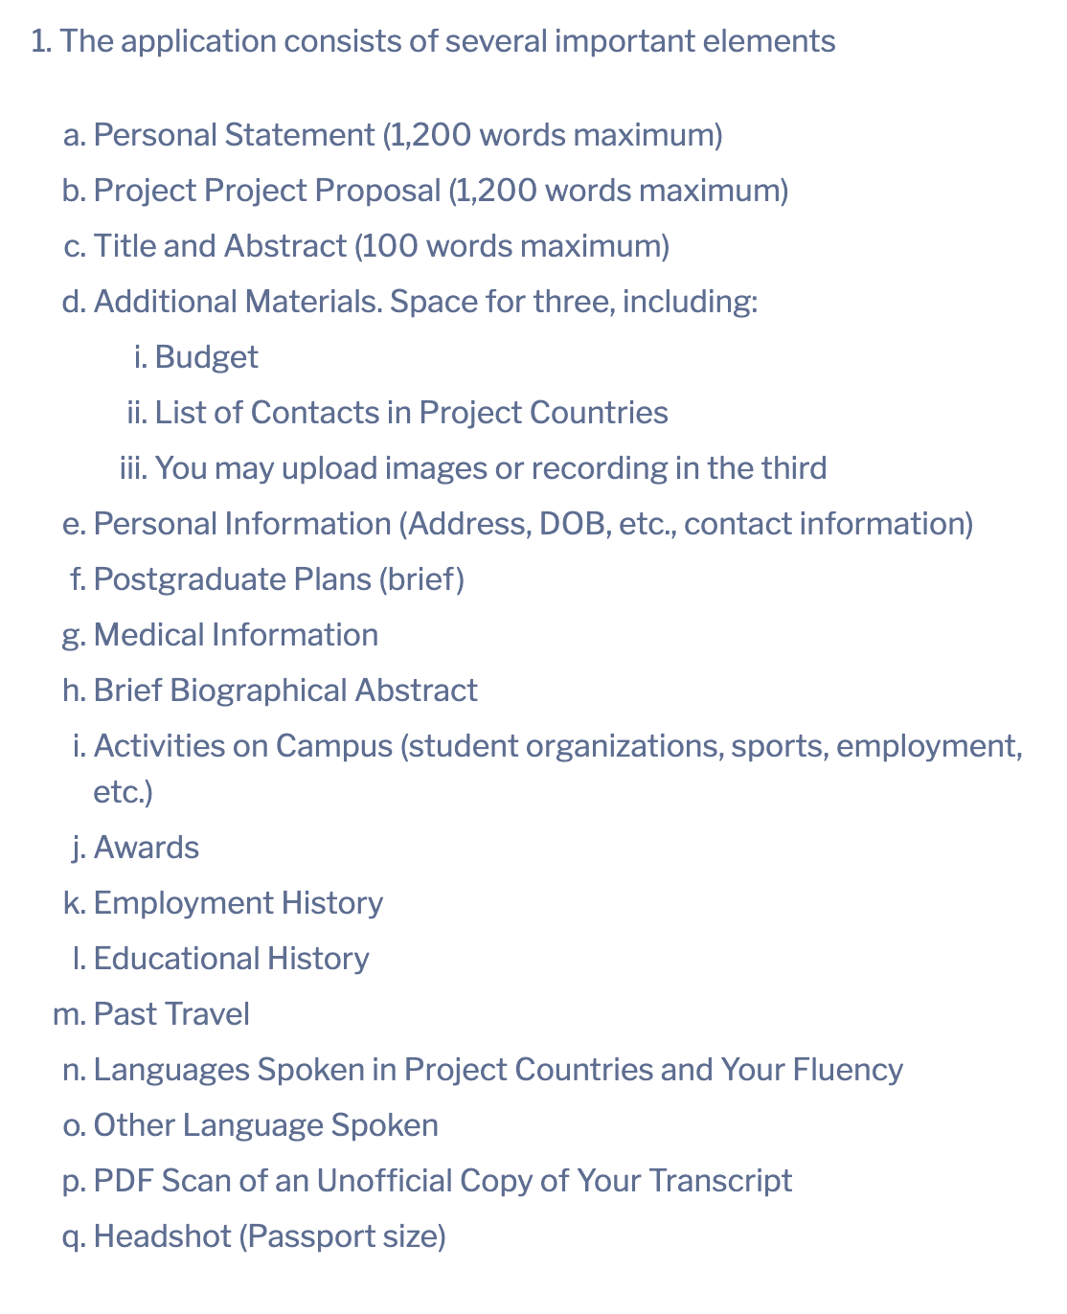
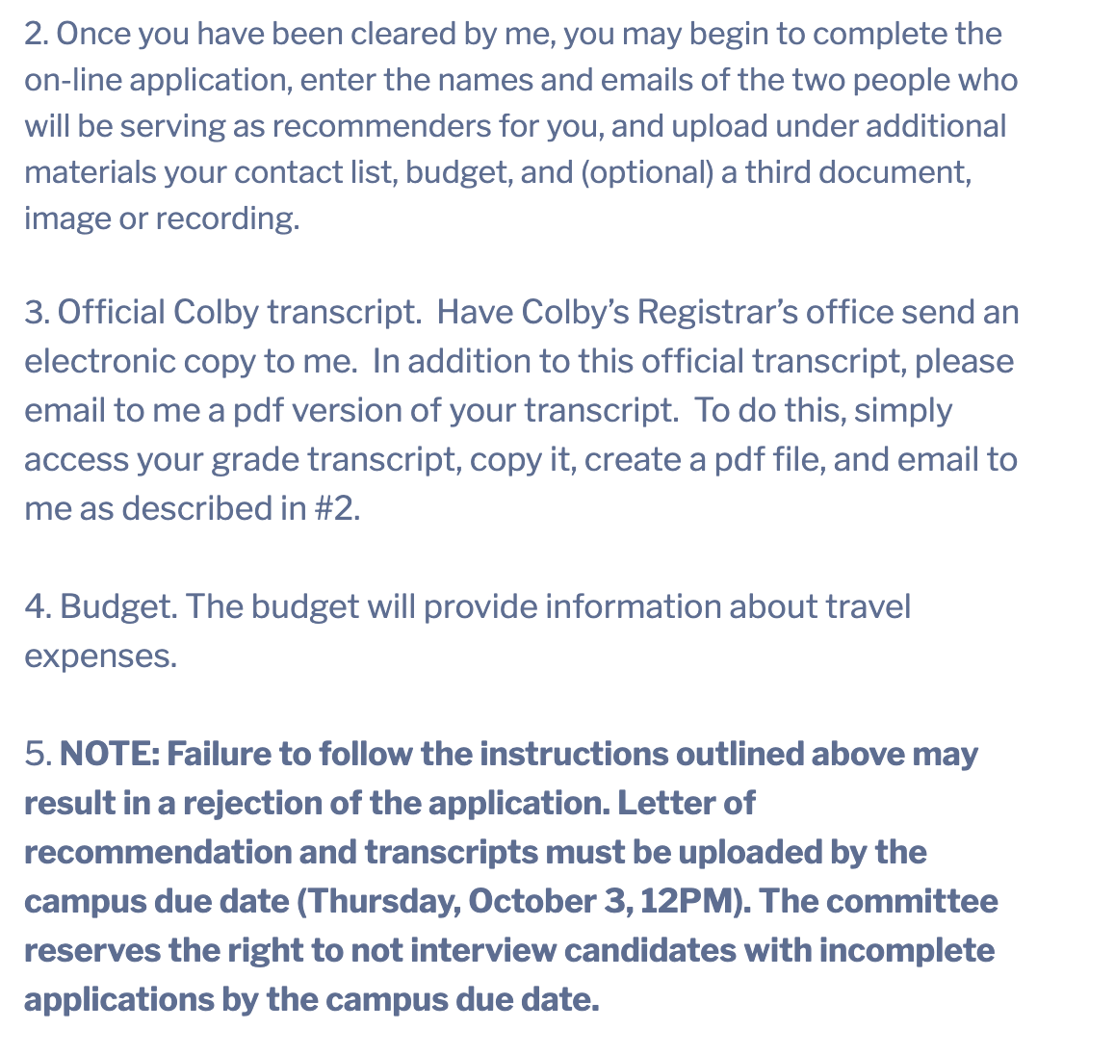
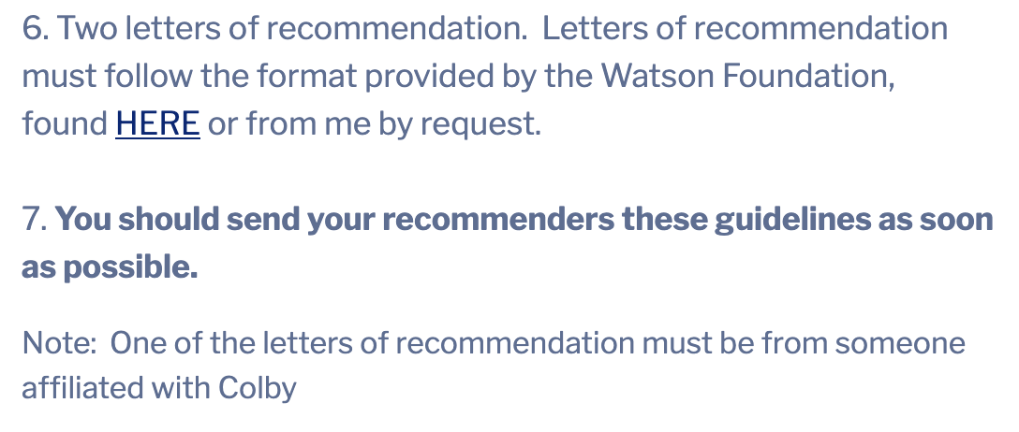

Slide 10
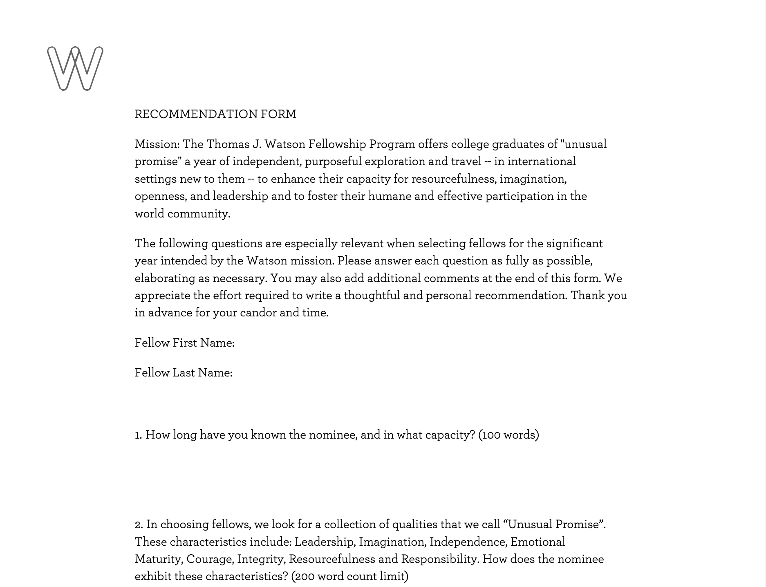

Slide 11
Application & Selection Process
1. Get my approval to start your application on the Foundation’s website.
2. Application has to be completed by Friday October 3rd at 12 noon. I will download the dossiers at 12:01.
On Friday 3rd, immediately following the deadline, be at the ready to be contacted to schedule your interview
3. Shortly after deadline, 15-minutes interviews will take place with the committee. Prepare an “elevator pitch” to get the ball rolling.
The Committee selects 4 nominees
IF SELECTED:
4. Work with committee members to revise your statement for submission – national deadline is November 5th at noon.
5. Between mid-November and late February 1-hour long interview with Foundation’s representative
5. Friday, March 13th announcement of the finalists

Slide 12
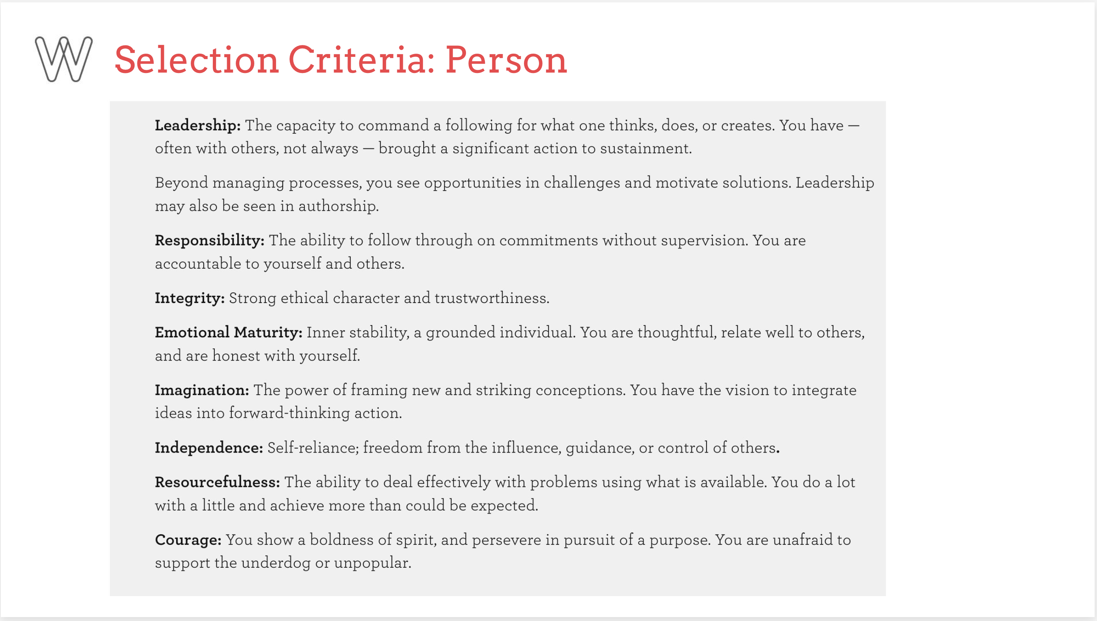

Slide 13
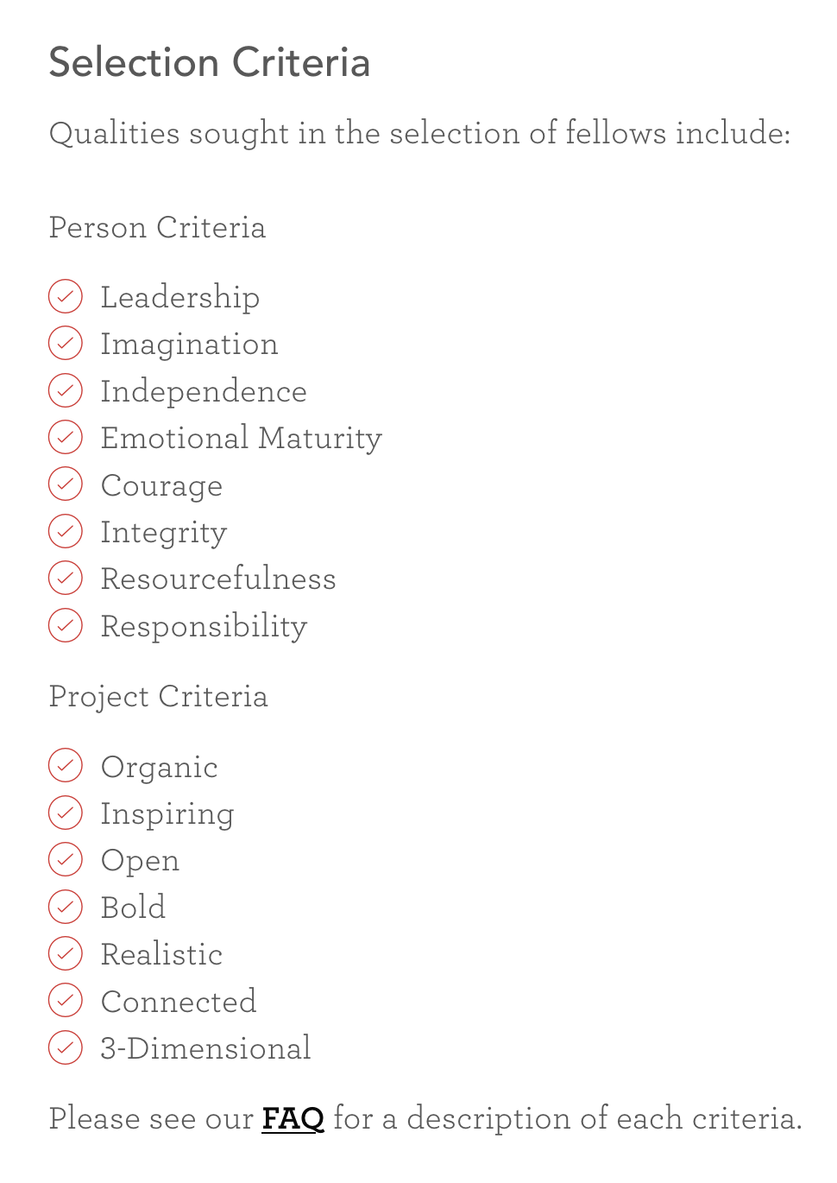

Slide 14
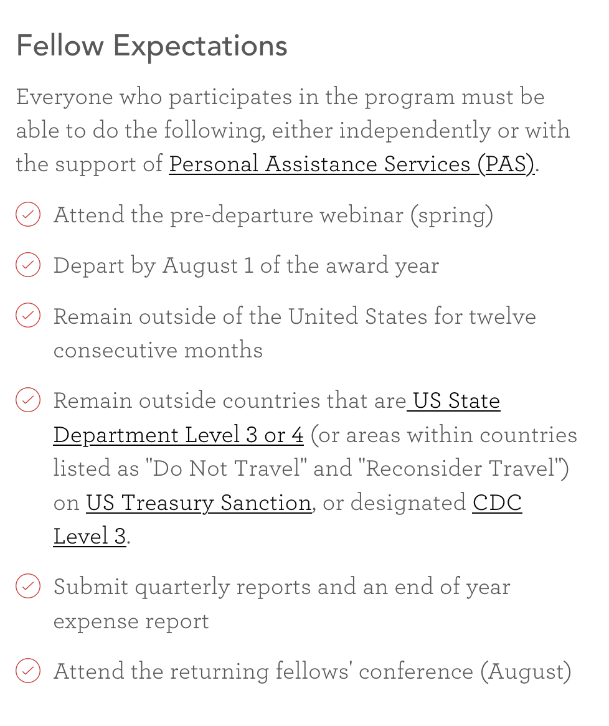

Slide 15
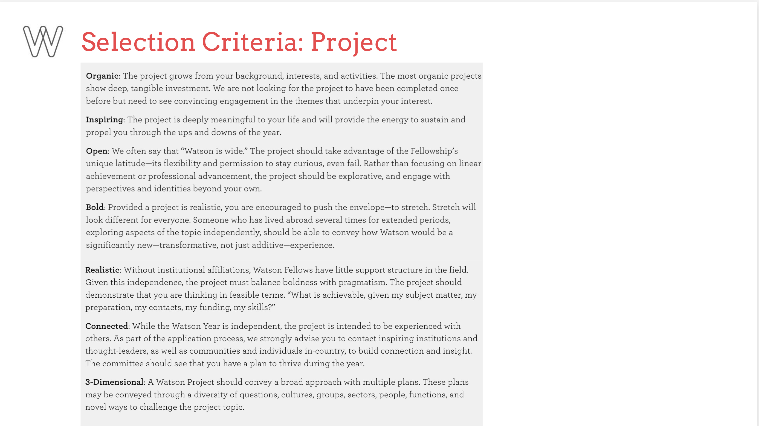

Slide 16
