Slide 1
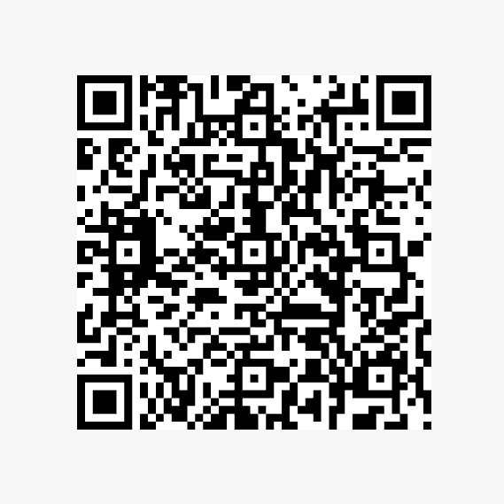
Watson Fellowships
Informational Session
Please check in:

Slide 2


Slide 3
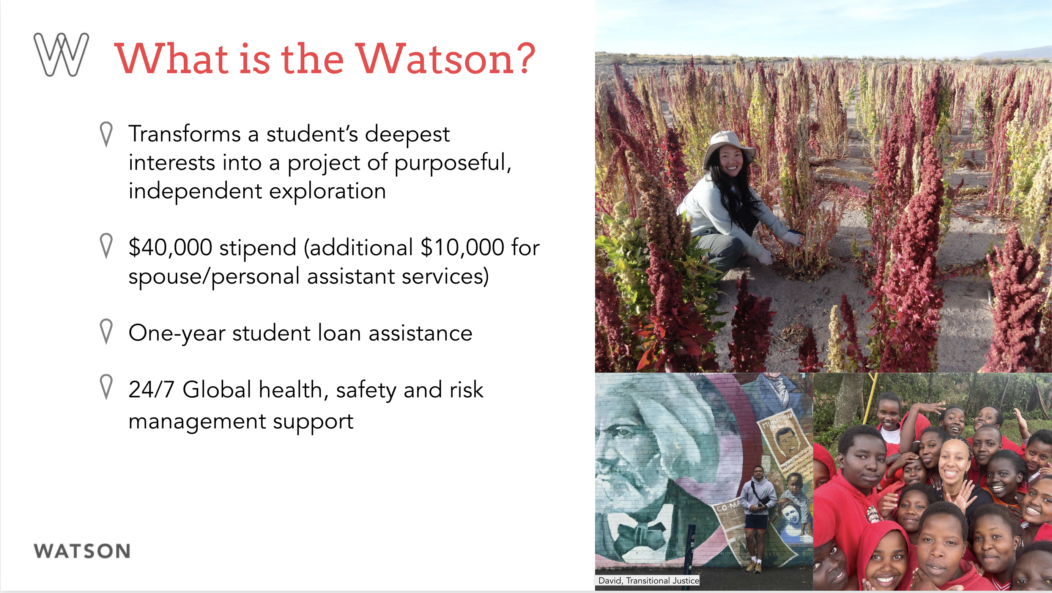

Slide 4
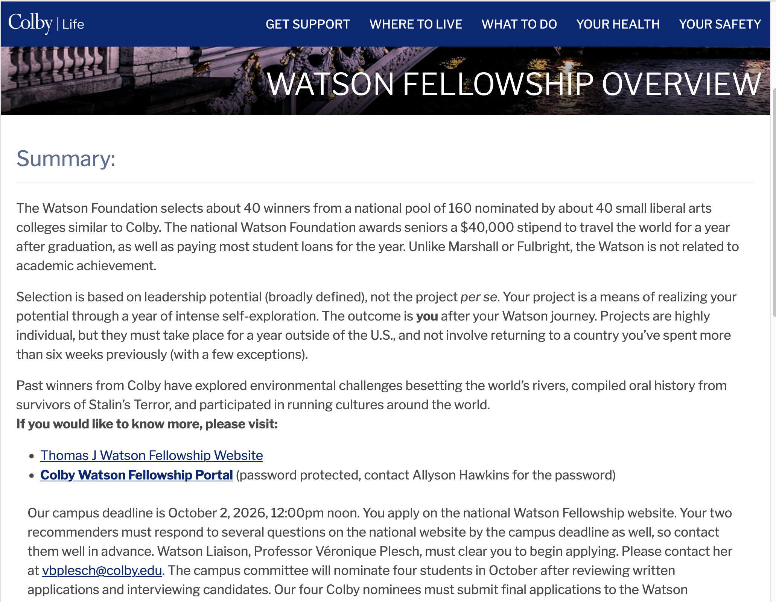
https://life.colby.edu/offcampus/watson-fellowship-overview/

Slide 5
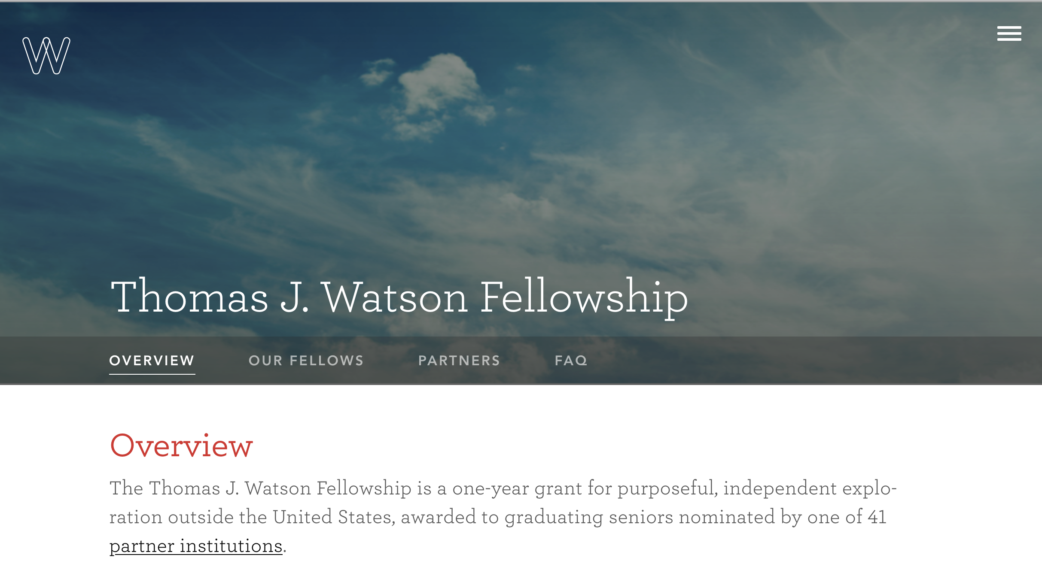
https://watson.foundation/fellowships/tj

Slide 6
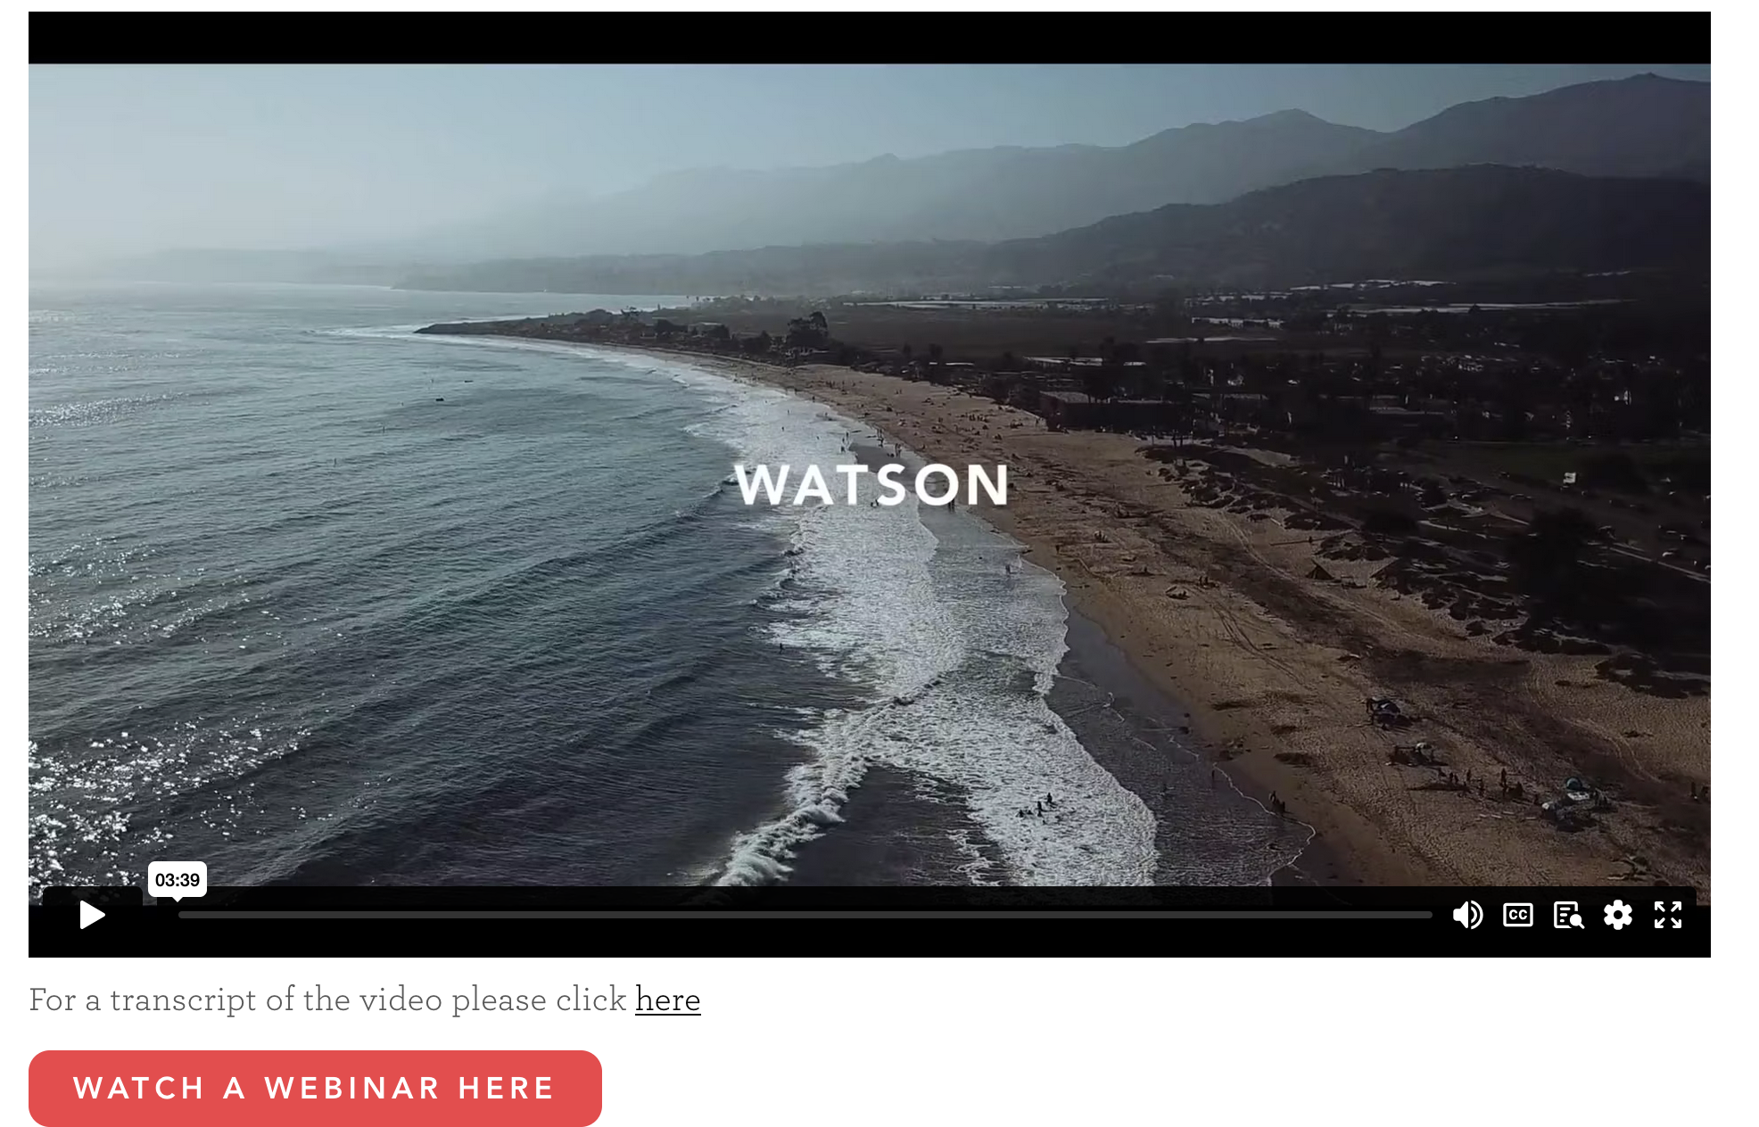

Slide 7
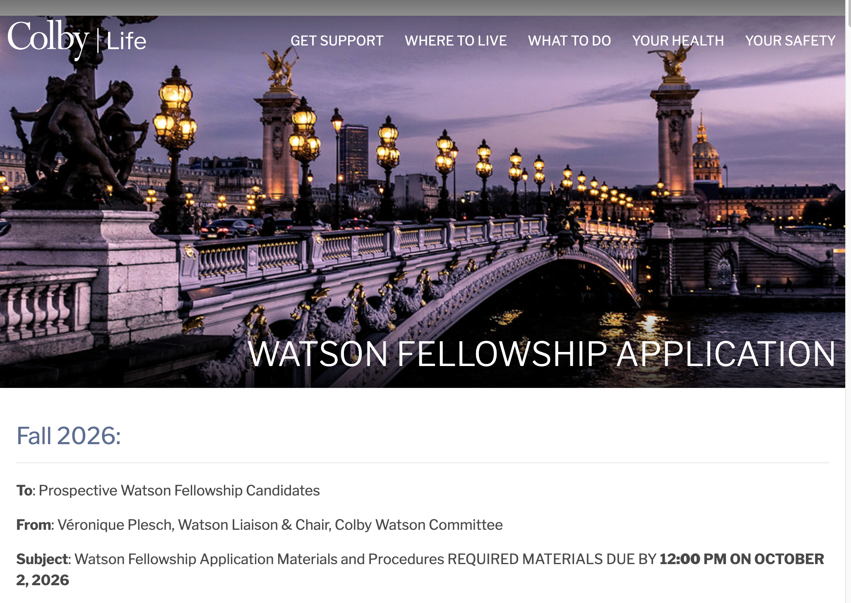
https://life.colby.edu/offcampus/watson-fellowship-application-procedures/

Slide 8
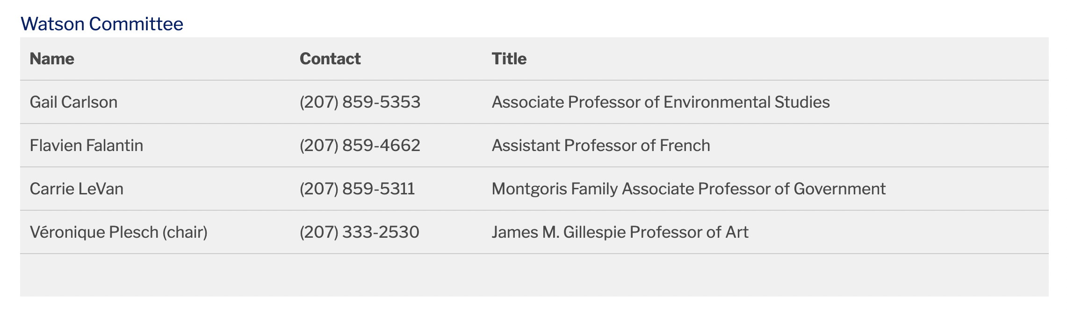

Slide 9
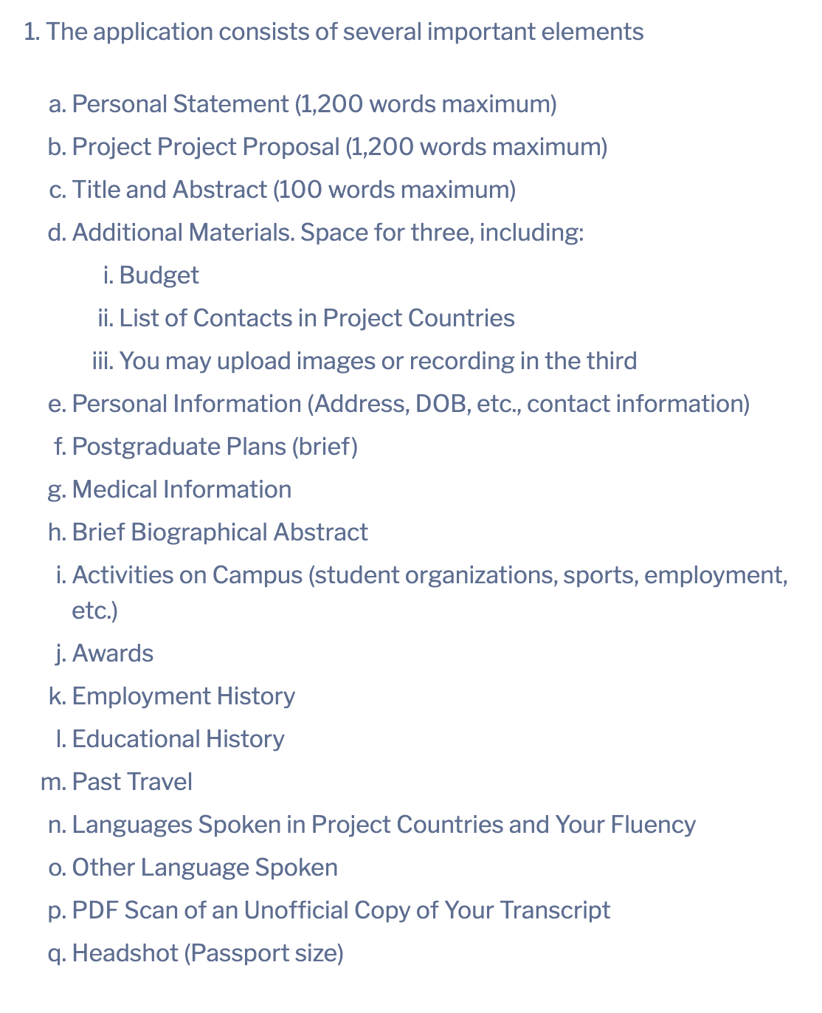

Slide 15
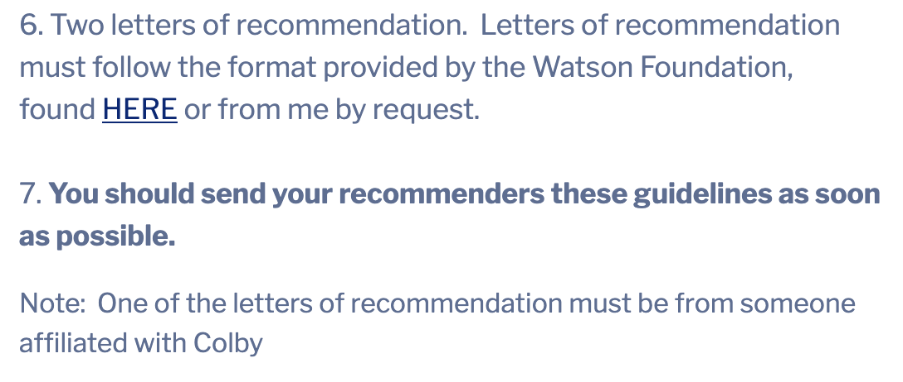
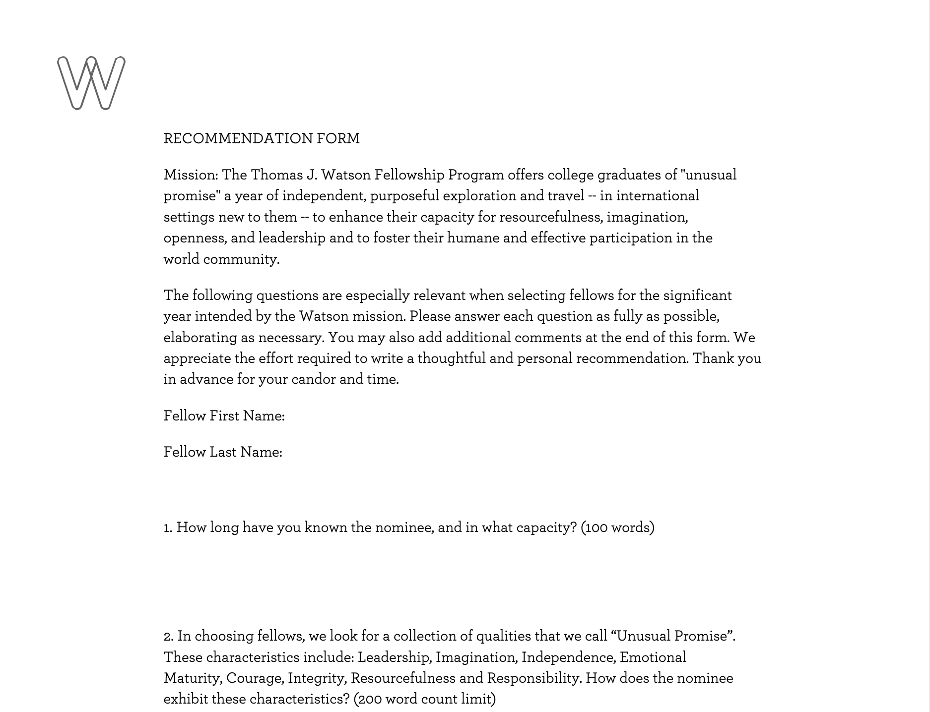

Slide 16
Application & Selection Process
1. Get my approval to start your application on the Foundation’s website.
2. Application has to be completed by Friday, October 2nd 2026 at 12 noon.
3. The committee conducts 15-minutes interviews.
4. The committee selects 4 nominees.
IF SELECTED:
5. Work with the committee to revise your statement for submission by the national deadline (November 4th 2026 at 12 noon).
6. Between mid-November and late February 1-hour long interview with Foundation’s representative.
7. Finalists are announced in mid-March.

Slide 17
What makes a good Watson Proposal?

Slide 18
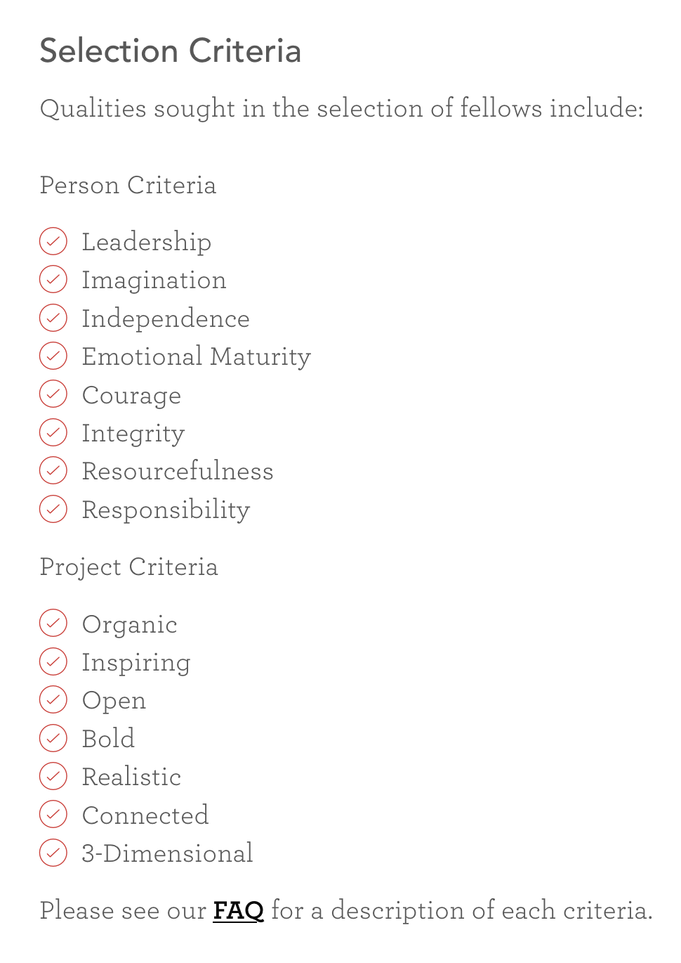

Slide 19
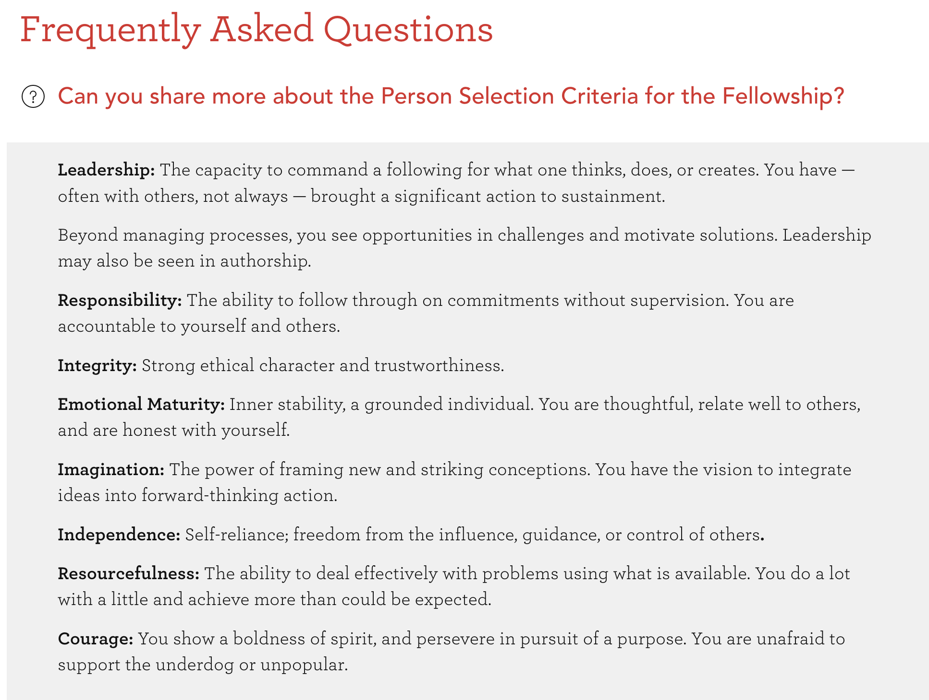

Slide 20
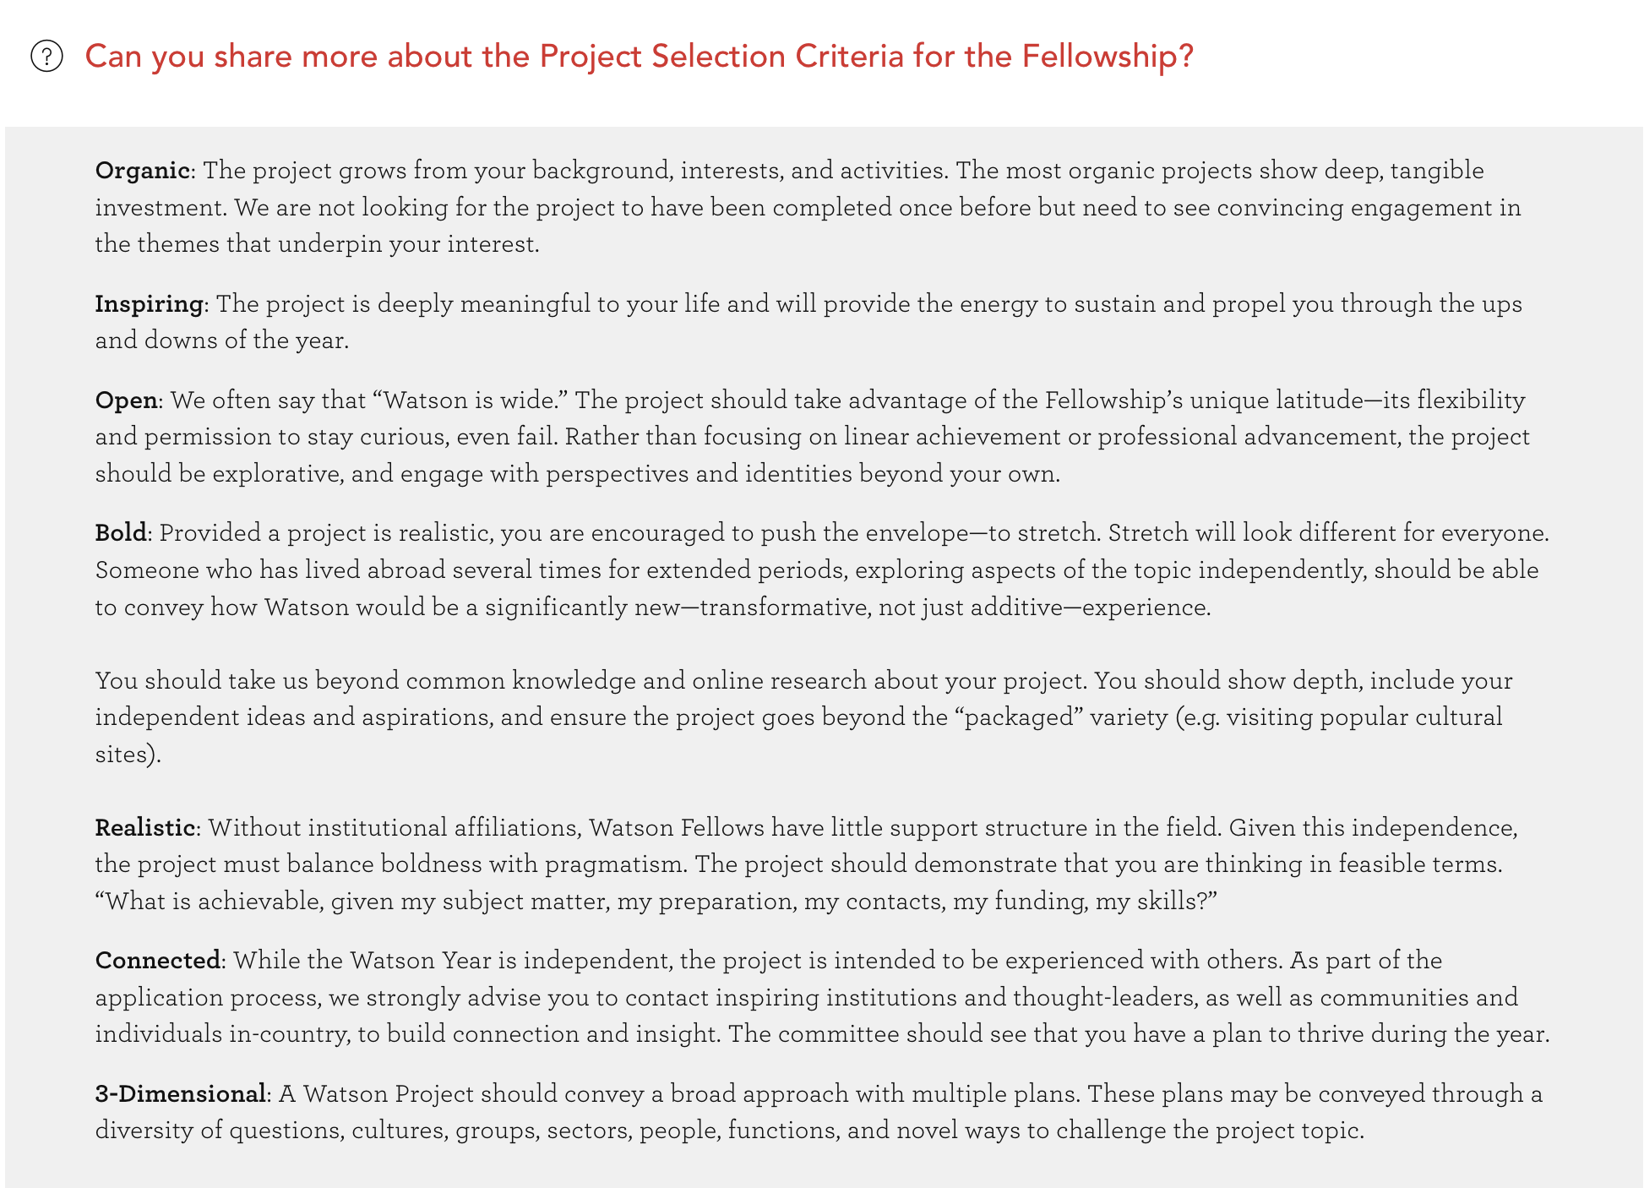

Slide 21
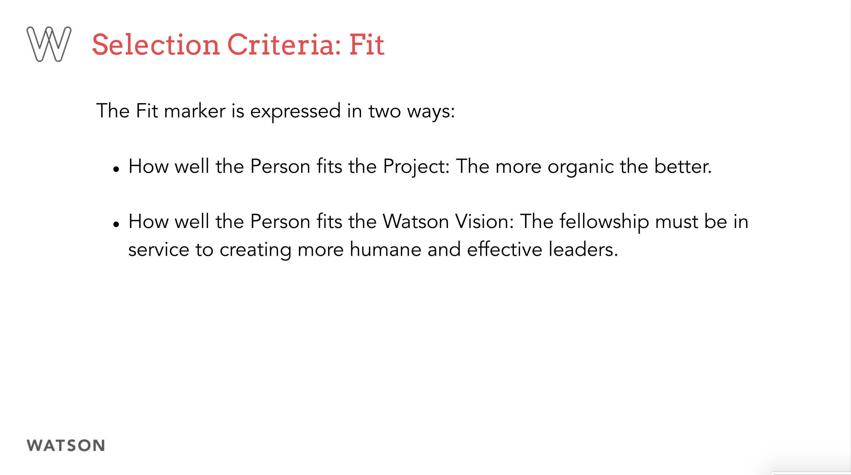

Slide 22
Further Advice

Slide 23
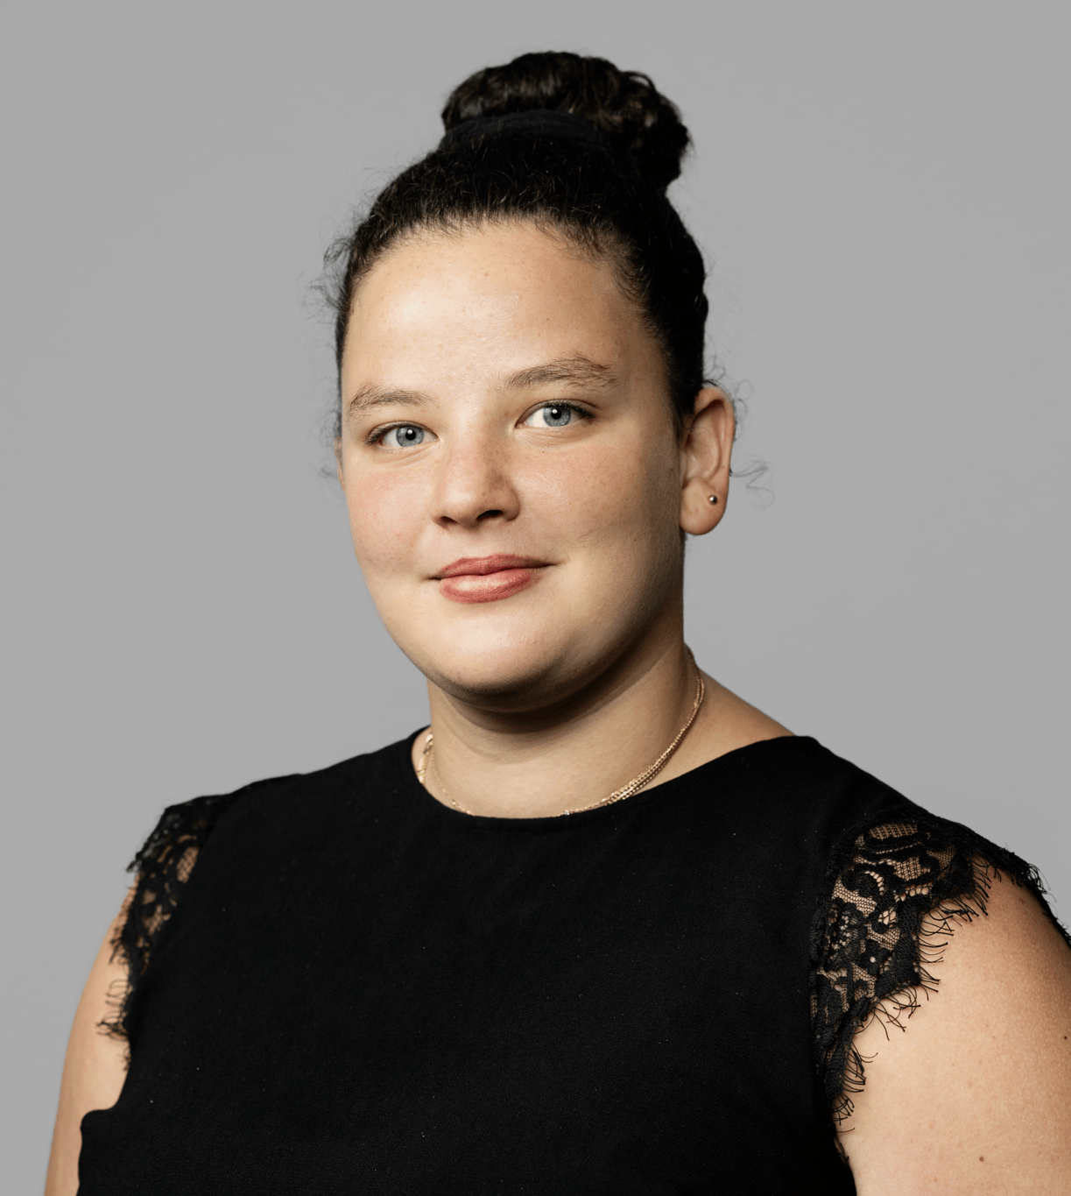
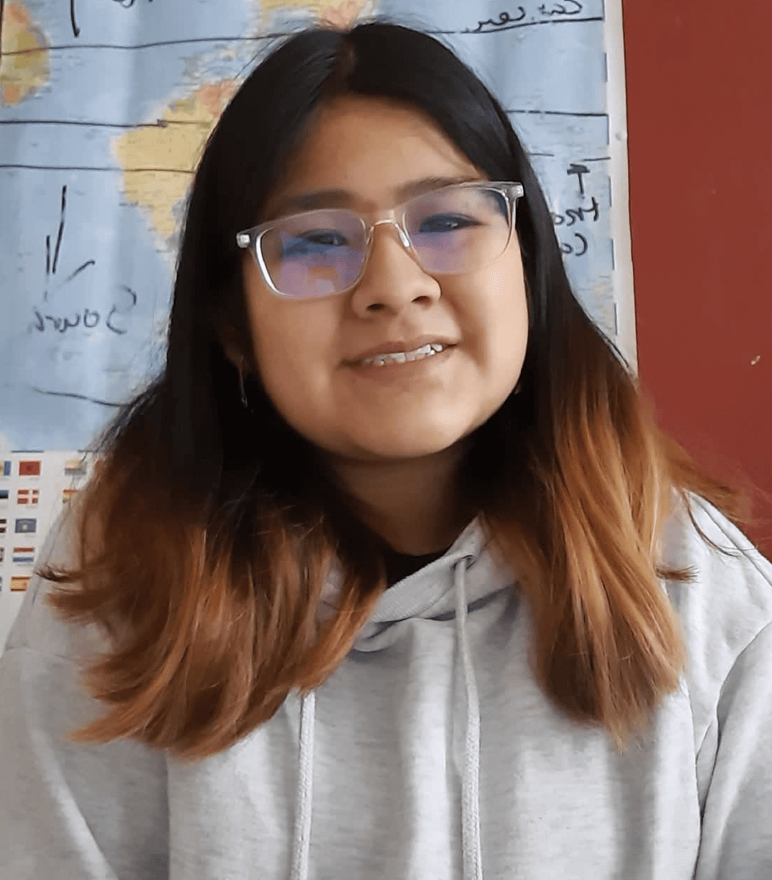
Ines Benjelloun
Crossroads of Care: Music as the Universal Drug
South Africa, Peru, Brazil, New Zealand, Nepal
Ana Cris Carhuavilca Alvarez
Exploring the Language of Textiles
Ecuador, Argentina, Jordan, India, Japan, Indonesia

